Slide 1
SKEDGE
Melanie Hynden
Tom Dale
Tersa Motbaynor Almaw

Slide 2
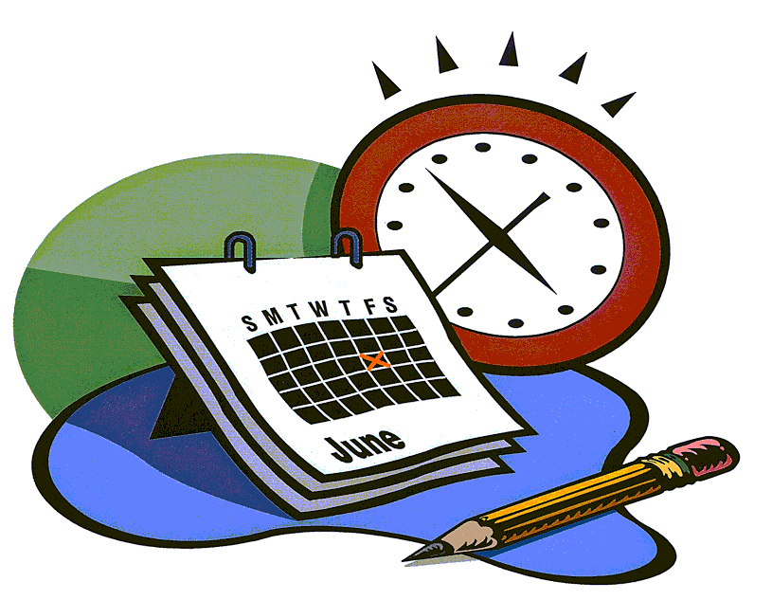
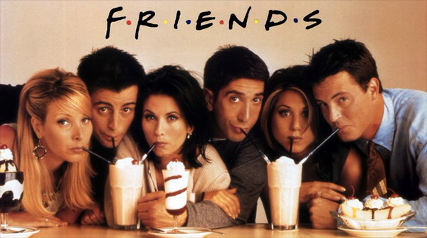
What it is
Schedule
Add/Delete Events
Events
Add Friends within
Prints Schedule
Makes planning events easier

Slide 3
What it includes
Classes
Events
Date/Time
Schedule
Object oriented
Vectors
File- input and output
Displays the users schedule

Slide 4
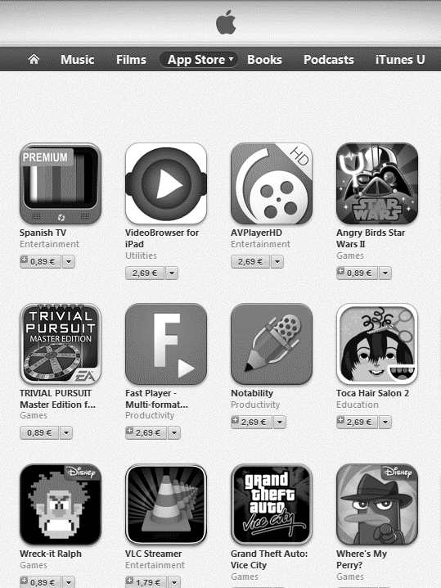

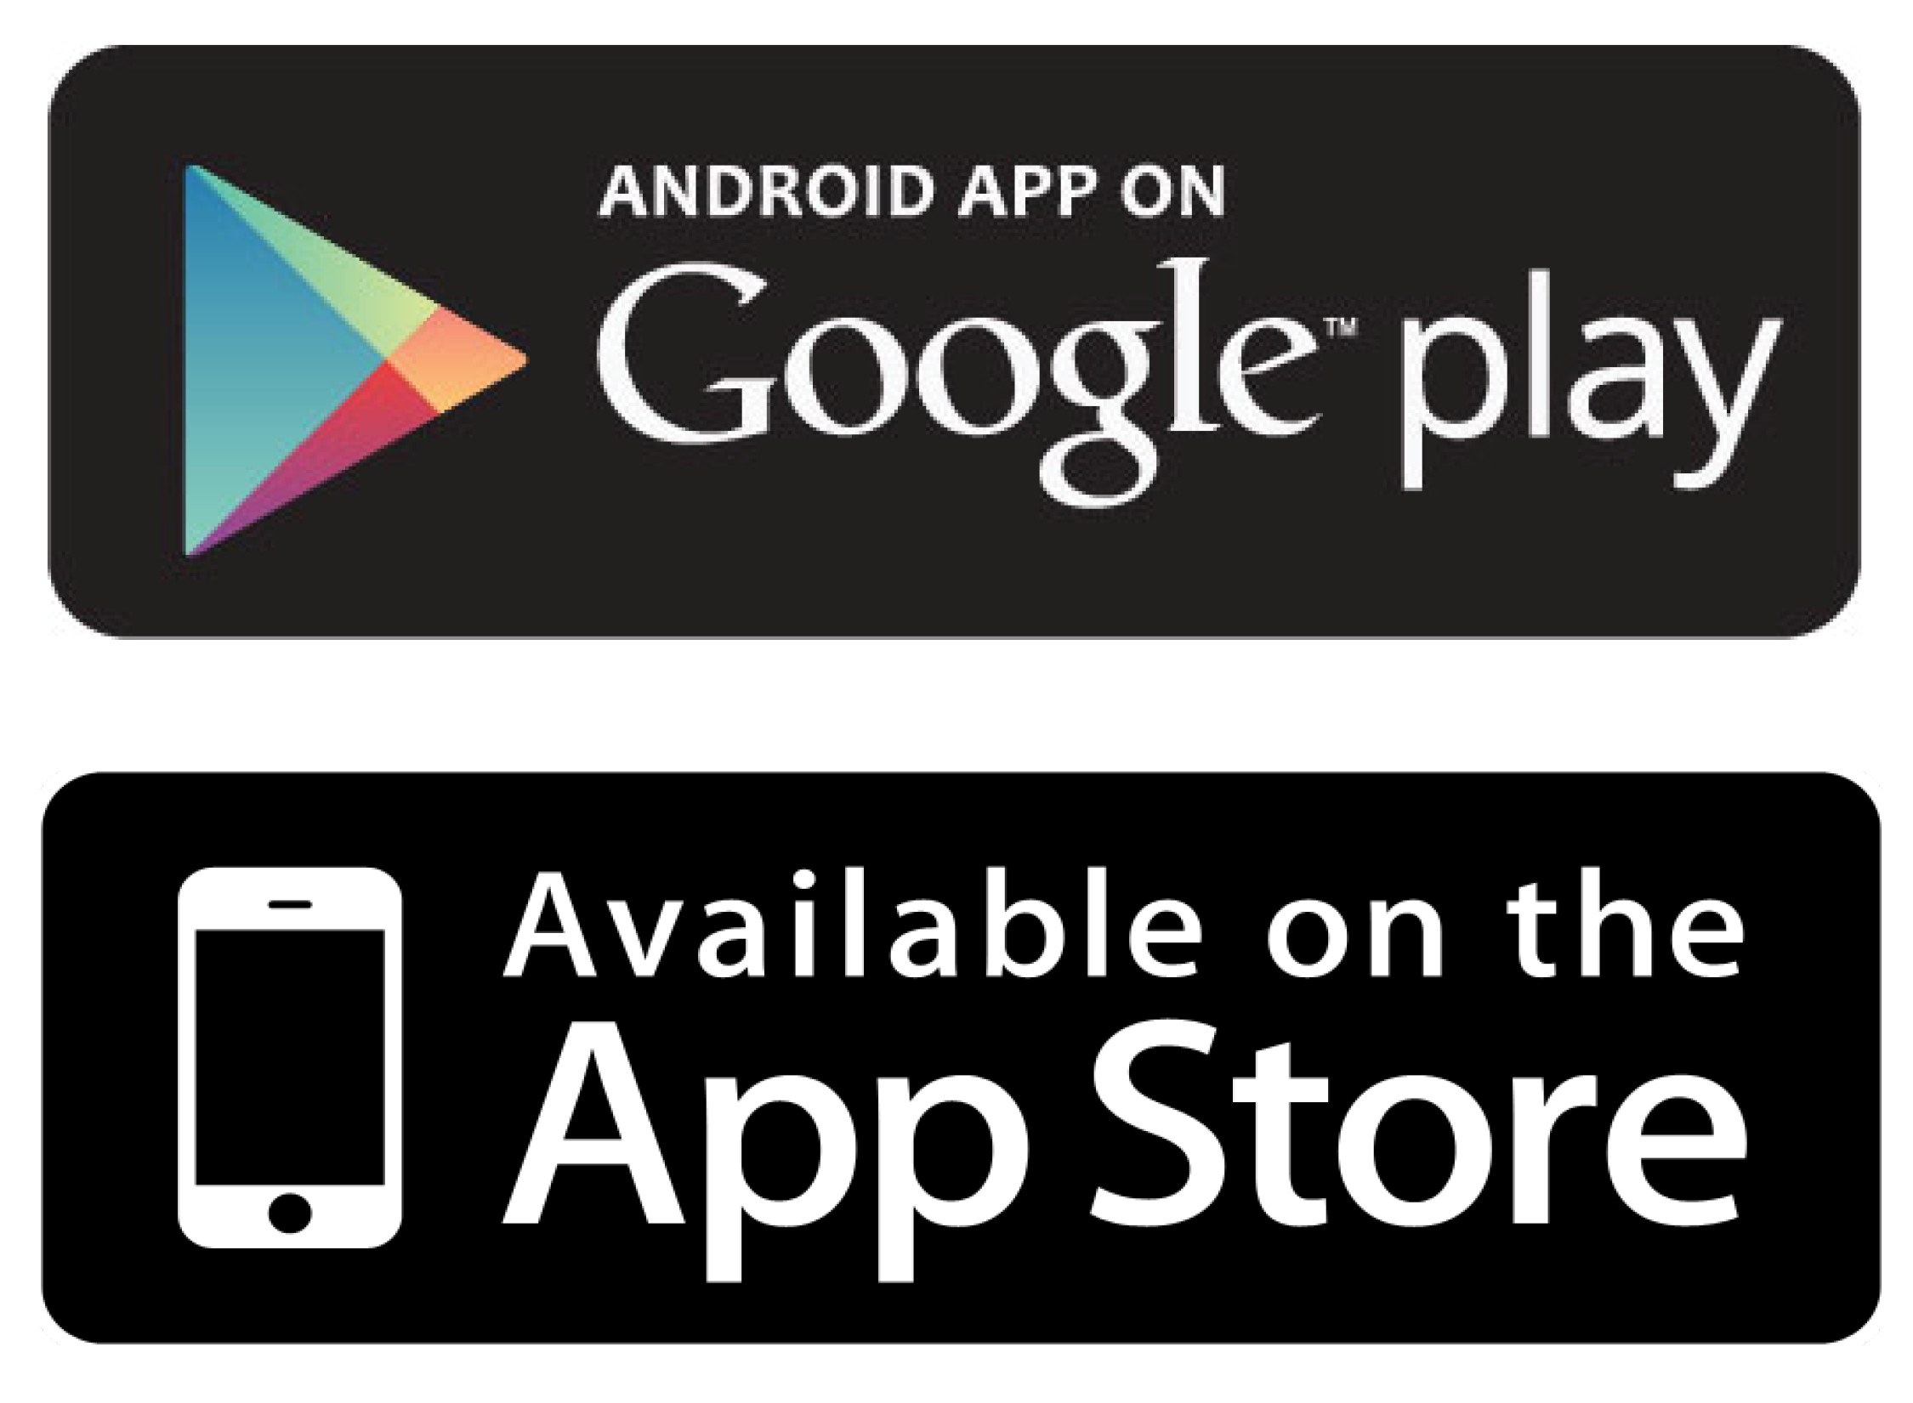
Favorite part
Creating the name
Useful – NEXT BIG THING!
The feeling of success overcoming juggling many files
Skedge
Productivity

Slide 5
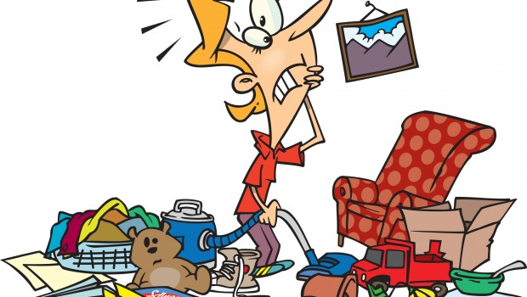
Challenges
Where to start?
NAMING VARIABLES
Dividing the work
Hard to see the whole picture
Testing/Debugging
User create account
Events object scheduling conflicts
Circular reasoning
Multiple users
File-output
Adding events based on the user
Event
Schedule
User

Slide 6
Questions

Slide 7
Thank you

